Slide 1
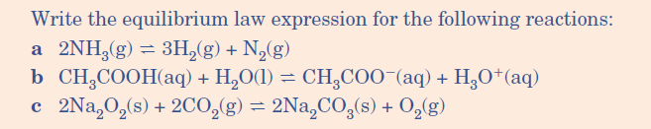


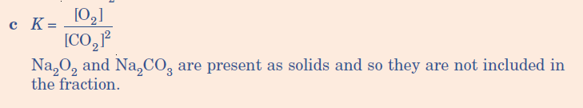
Quick Quiz
Remember (l) and (s) are not included in the equations only (aq) and (g) !

Slide 2
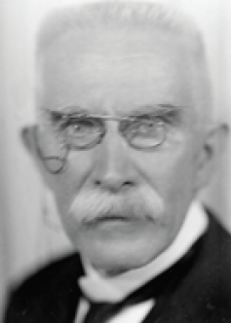

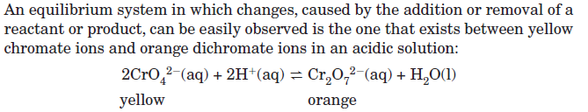
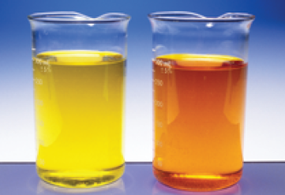

Henri Louis Le Châtelier (1850 –1936) was an influential French chemist of the late 19th and early 20th centuries. He is most famous for devising Le Châtelier's principle, used by chemists to predict the effect a changing condition has on a system in chemical equilibrium

Slide 3
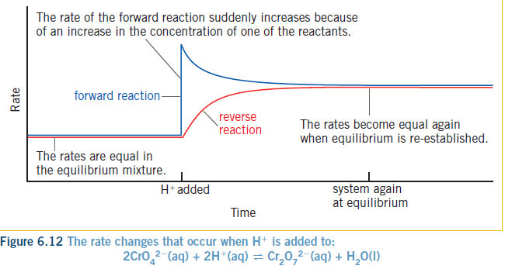

Slide 4
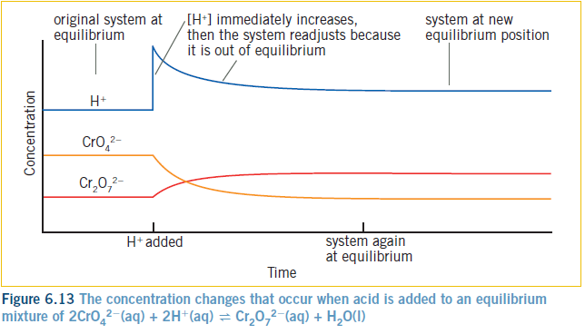

Slide 5



Notes:
The only thing that affects K permanently is heat. This is because the endothermic side is more affected, and you are changing strong bonds to weak bonds, so absorbing heat. Ref page 15

Slide 6
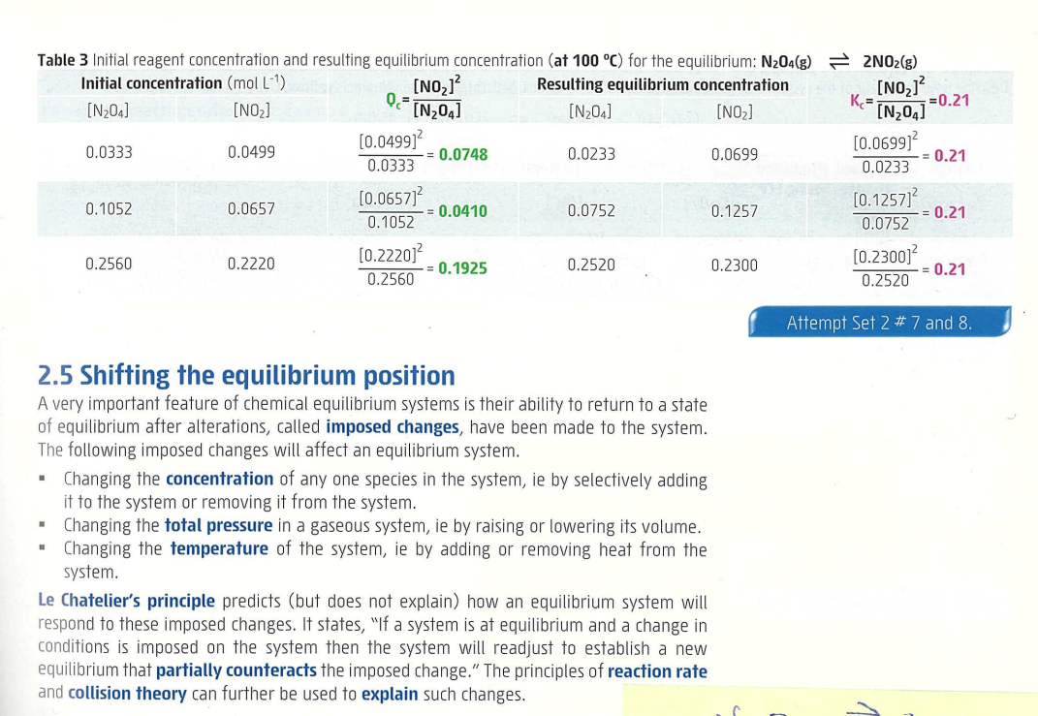
The only condition that affects k permanently is heat.

Slide 7
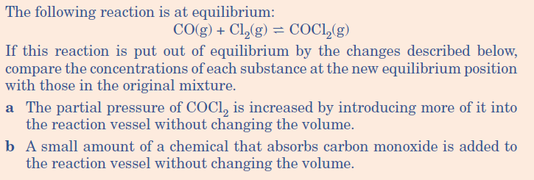
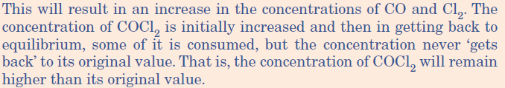

Slide 8


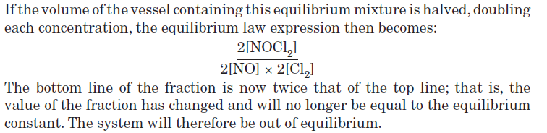
Equilibrium will re-adjust to decrease the pressure and move to the side that produces
Less volume so move to the product side and NOCl₂ concentration will increase

Slide 9
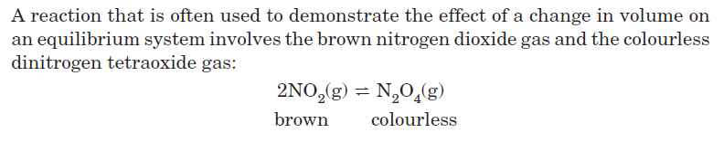
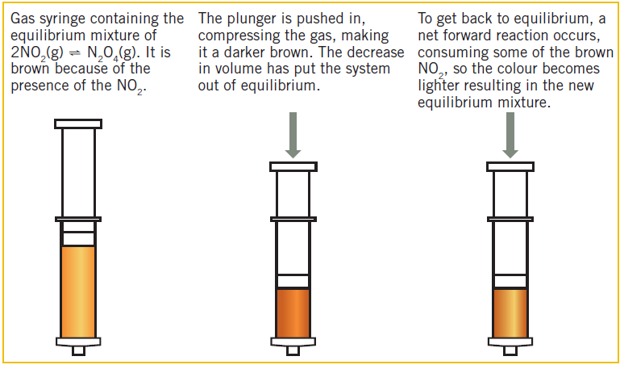

Slide 10
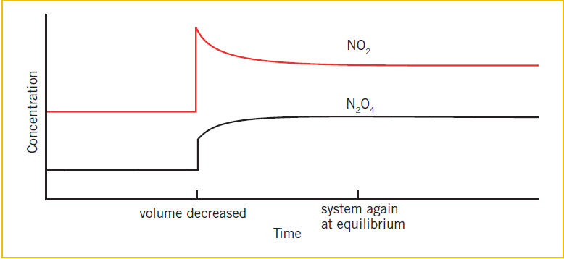

Slide 11


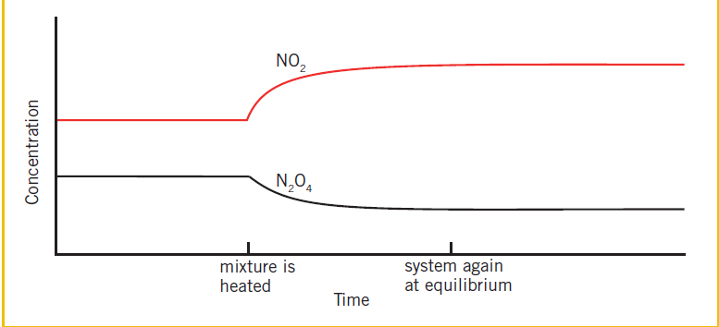

Slide 12
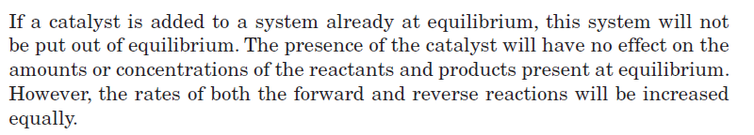

Slide 13
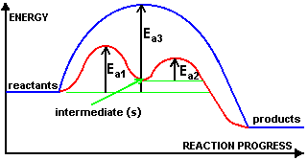

Slide 14
Haber process
Manufacture of ammonia NH₃ for the fertilizer industry
N₂
3 H₂
2 NH₃
H= - 92.4kJ
+
2
NH₃
Kc =
N₂
H₂
3
x

Slide 15
Haber process
Manufacture of ammonia NH₃ for the fertilizer industry
N₂
3 H₂
2 NH₃
H= - 92.4 kJ
+
Le Chatelier’s principle predicts the yield of NH₃ is maximised by
Low temperature
High pressure
Actual temp used is 500ºC (as lower temp reduces the rate )
Pressure used is 200 ATM

Slide 16

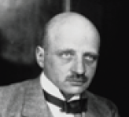

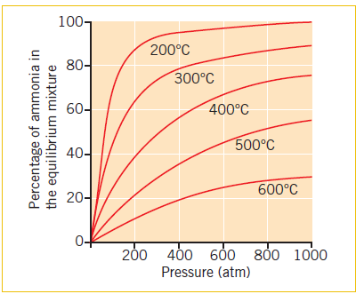
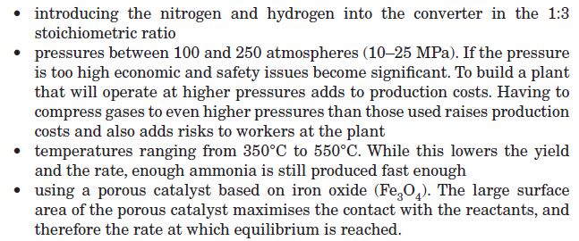

Slide 17
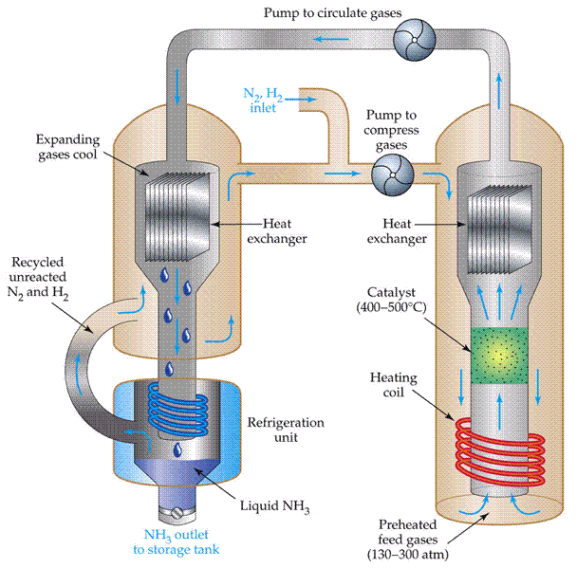

Slide 18
Contact process
Part of the Manufacture of Sulfuric acid H₂SO₄
2SO₂
O₂
2 SO₃
H= - 198kJ
+
Le Chatelier’s principle predicts the yield of SO₃ is maximised by
Low temperature
High pressure
Actual temp used is 450 ºC (as low temp reduces the rate )
Pressure used is 1 ATM

Slide 19
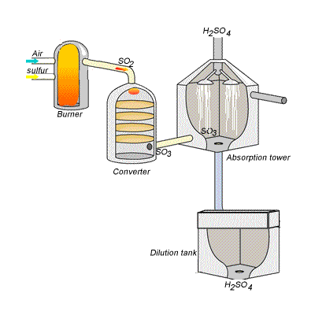

Slide 20
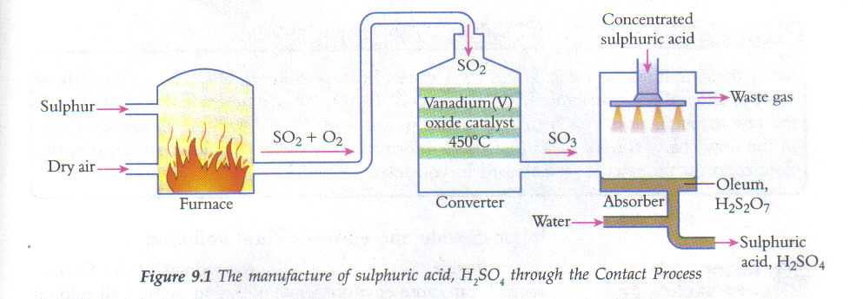

Slide 21
You are to produce a summary sheet on the Contact Process.
Points to address/research:
4 equations one is a reversible reaction what can you change to favour the forward reaction.
Macroscopic properties, temp, pressure, catalysts.
What is produced?
Exo or endothermic process?
Uses of H₂SO₄?
Lucarelli page 169-171

